Slide 1
SourceZero
Zero Gray, Farhat Zafar, Taina Menende

Slide 2
Description
Source Zero is an online market with highly curated organic groceries for all diets sourced with transparency at an affordable price through a membership based model.
The application will offer users the ability to manage their accounts and subscriptions with ease. It will also include intuitive navigation through available organic products, allowing customers to browse, search, and filter items based on their preferences. Additionally, the app will feature a customer support chat, providing real-time assistance to ensure a smooth and reliable user experience.

Slide 3

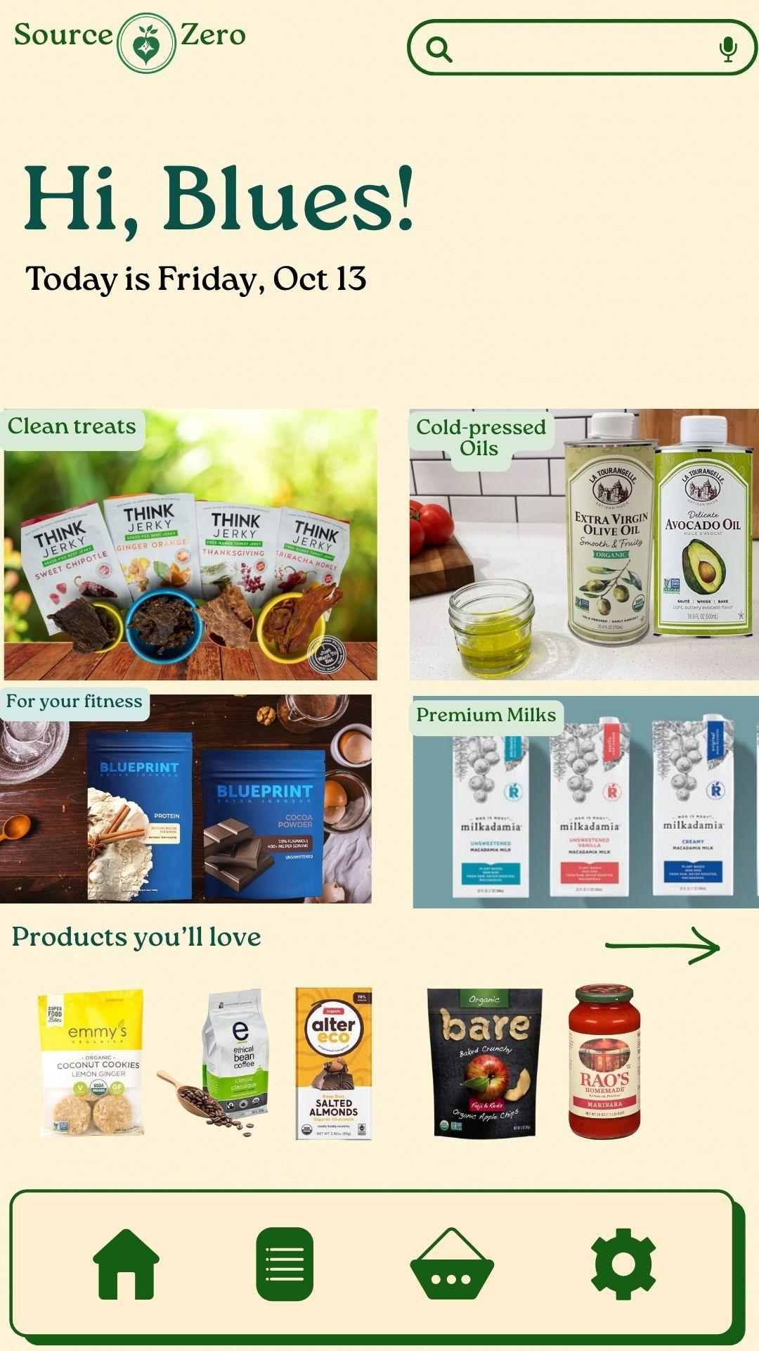
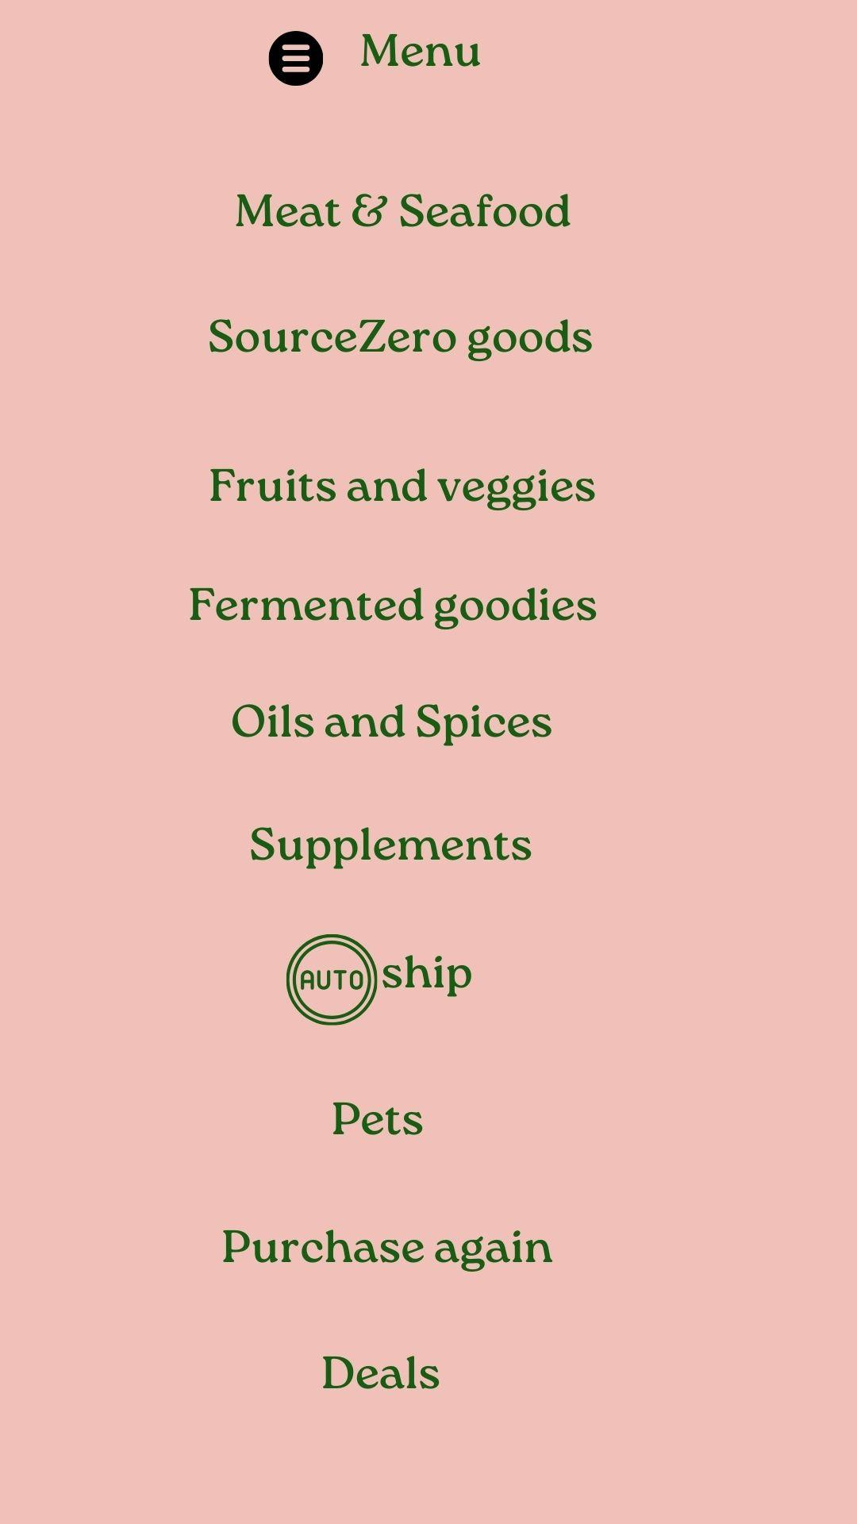
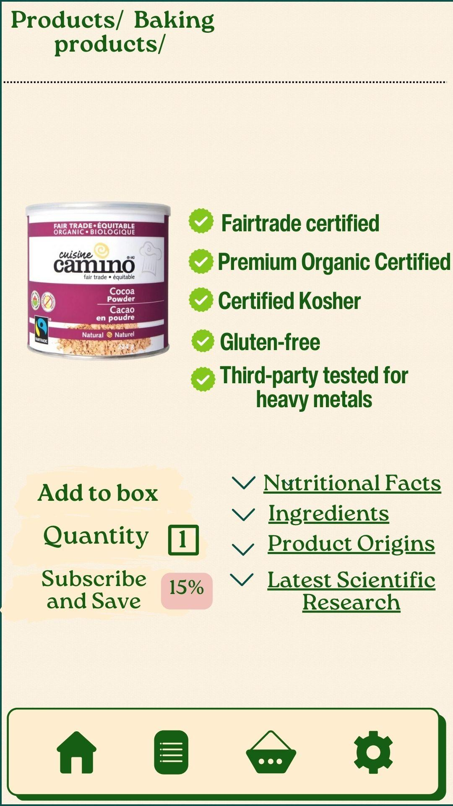
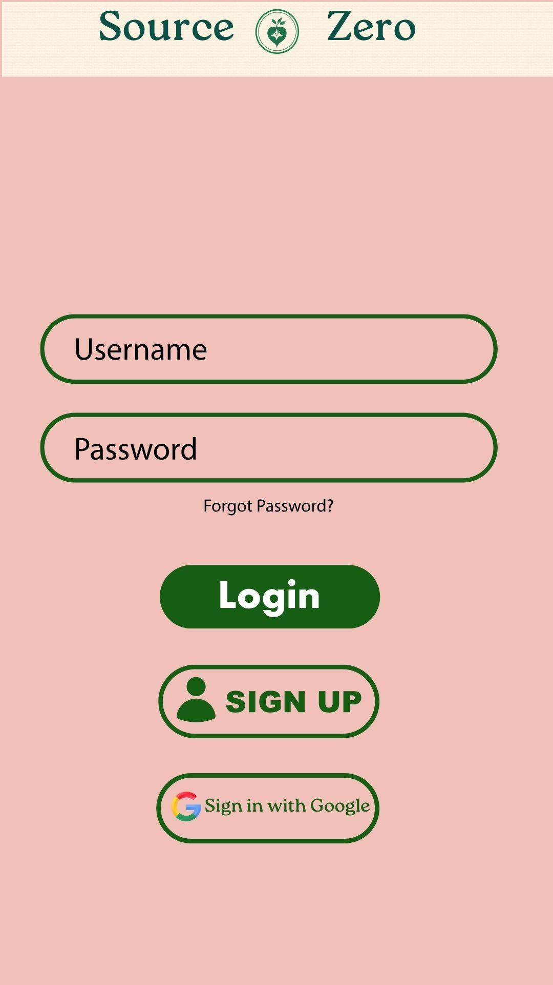
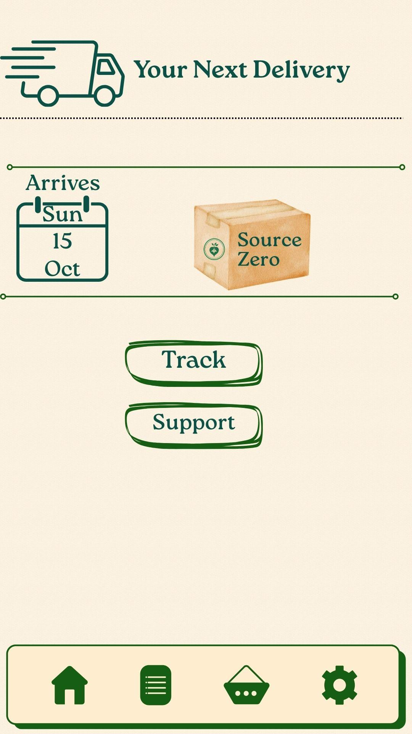
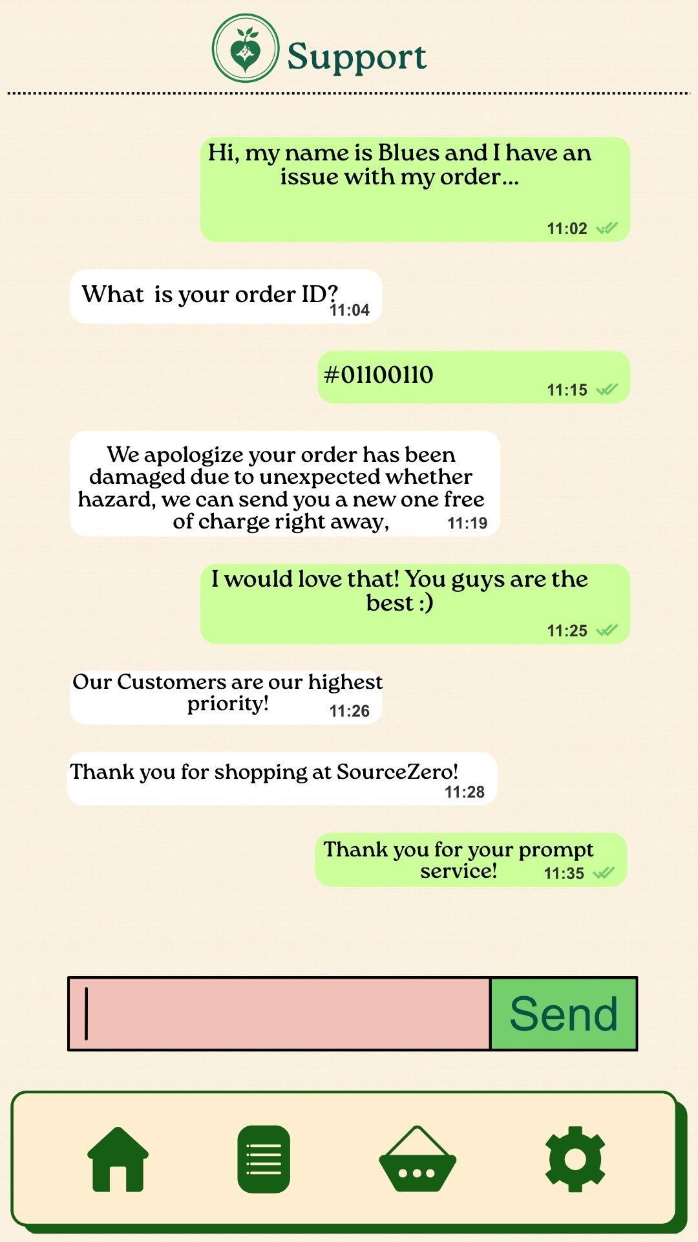
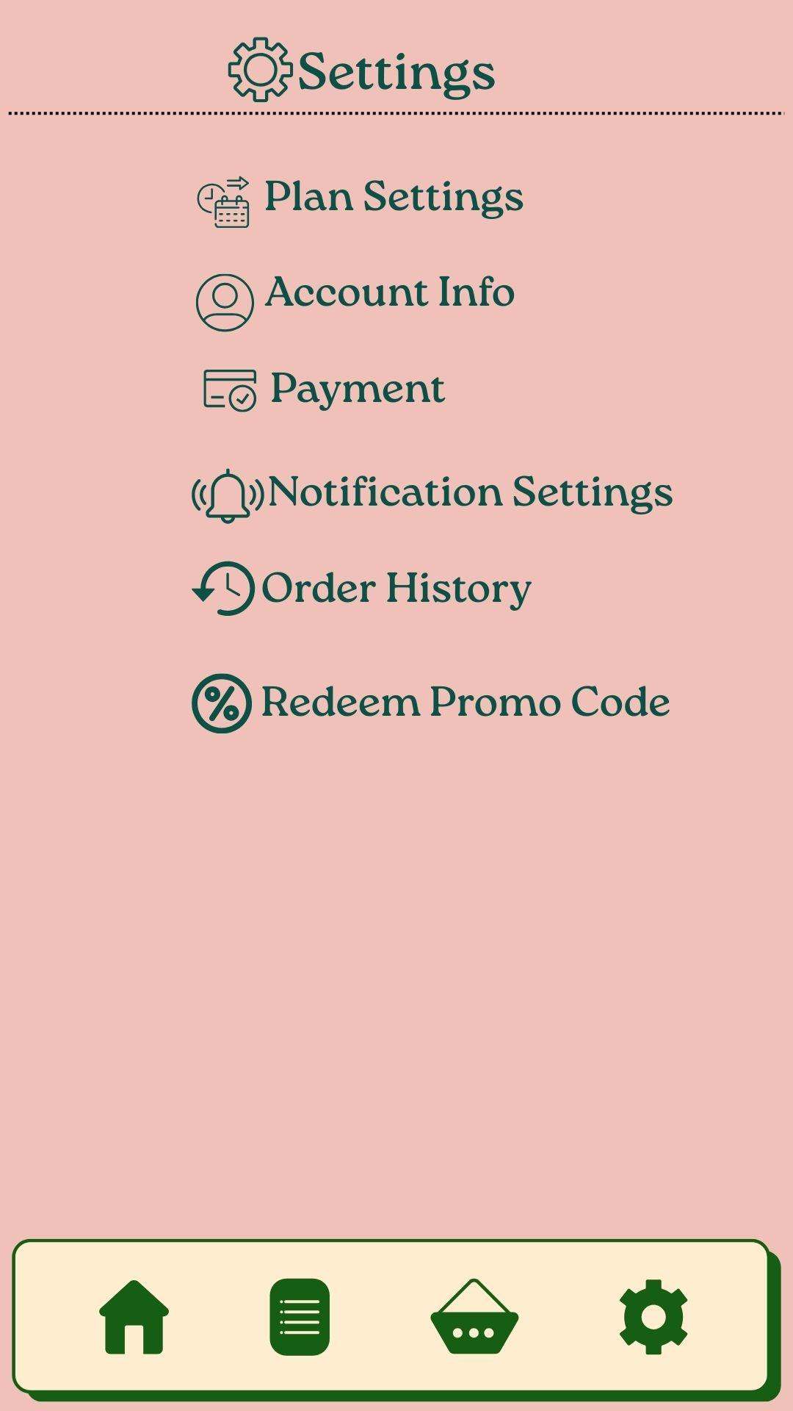
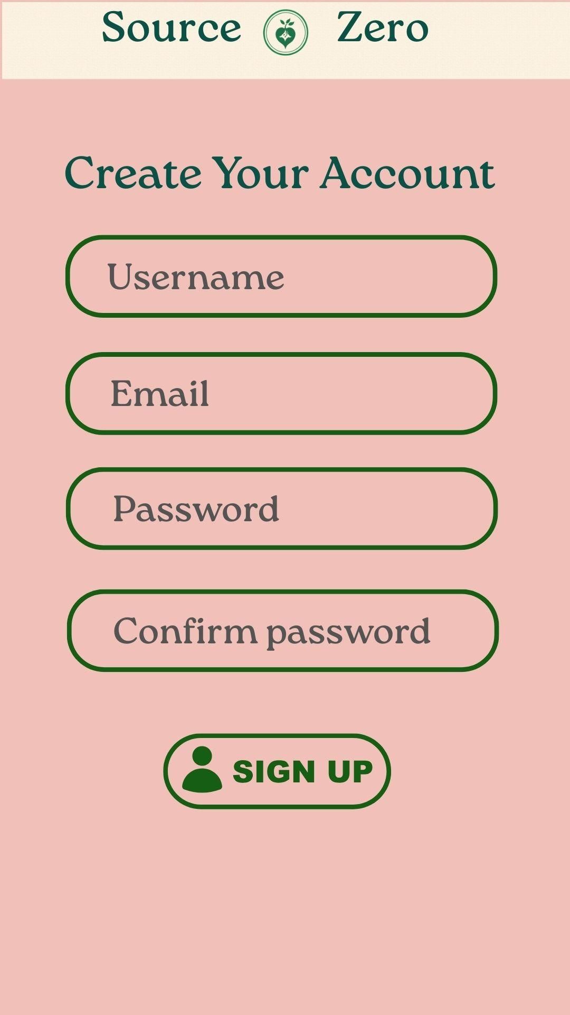
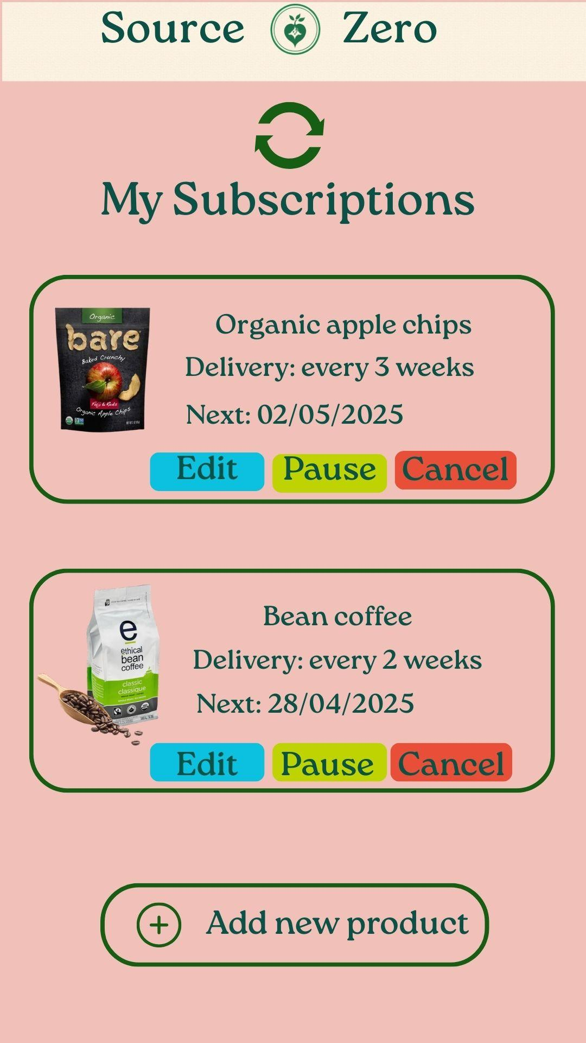
Mockup:

Slide 4
First Screen
The initial screen that a user sees when they open our app

Slide 5
Login Screen
Login screen requires username and password
Forgot password option
Sign up button brings users to registration page
Sign in with Google option

Slide 6
Registration Screen
Registration form requires username, email, password and a confirmation of the password

Slide 7
Home Screen
Home page displayed once user has successfully logged in
Personalized greeting
Product suggestions
Search bar

Slide 8
Menu Screen
Menu screen can be used to filter products
Purchase again for order history
Deals for promotions

Slide 9
Product Details Screen
Product details with labels, quantity and nutritional facts

Slide 10
Delivery Screen
Delivery tracking screen with approximate delivery date
Option to contact support

Slide 11
Support Screen
Support chat for customer inquiries

Slide 12
Setting Screen
Settings screen for adjusting membership plan, account information, payment information
Viewing order history
Redeeming discounts

Slide 13
Subscriptions Screen
Subscriptions screen showing user’s personalized subscriptions to products
These items are automatically reordered

Slide 14
Additional info
Number of screen flows: 10
Chosen Database: Firebase
GitHub link: https://github.com/adinashby-vanier-college/app-dev-2-project-source-zero-mobile

